Slide 1
Mainstream: Dynamic Stem-Sharing for Multi-Tenant Video Processing
Angela Jiang
Daniel L.-K. Wong, Christopher Canel, Ishan Misra,
Michael Kaminsky, Michael Kozuch, Babu Pillai,
David G. Andersen, Greg Ganger

Slide 2
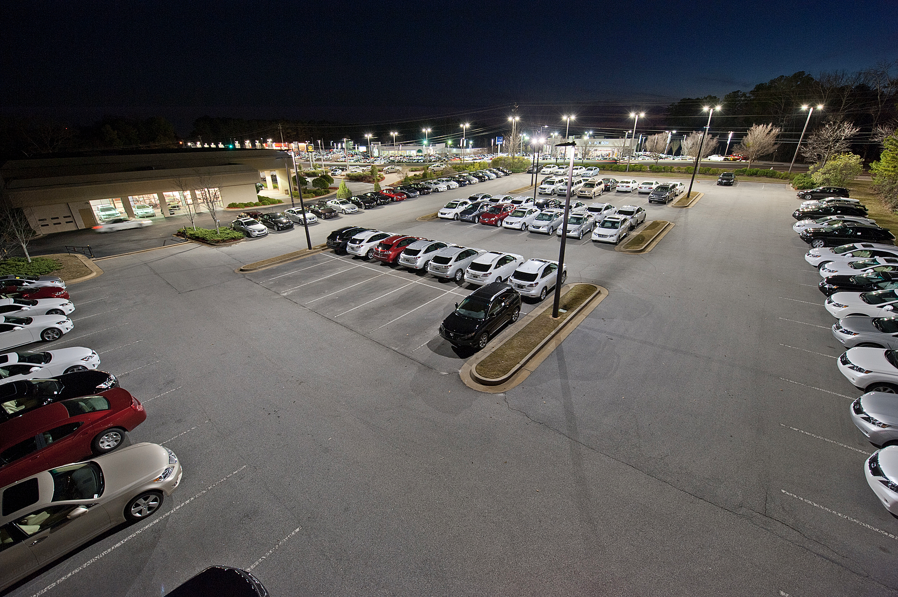
Parking violation monitor
Fender-bender monitor
Parking spot finder
Chevy Tahoe detector
Notes:
Imagine that you have a camera, generating a video stream of the parking lot. And this camera is attached to some edge compute resources. You can imagine that there are a lot ways you’d want to use these edge resources to analyze the video stream in real time

Slide 3
Mainstream: runtime optimization of applications
Problem #1: Video analysis applications do DNN inference
Running several full DNNs becomes very slow
Mainstream reduces contention by sharing redundant computation
Without centralized training data and process
Problem #2: Applications developed in isolation and offline
Without understanding of the resources available
Mainstream dynamically tunes DNNs at runtime
Notes:
Virtually infinite but constrained by cost
Nobody knows where this is going
late-binding
If your resources are finite, best accuracy occurs if the characteristics of how the app is doing in the analysis is specialized to the amount of resources we have. The close that people do is to assume infinte resources, or very limited and smallest that they can. It’s not really either and the person developing the app isn’t gonna know. Developed in isolation but not gonna run that way. Foffloatding the optimization steps to scheduling time. Run multiple apps . Specialize to amount of resources -> better behavior. Also know run multiple things on video streams. App developer that’s assuming theres is the only thing can’t possibly know what’s going to available, 1) where they’re running probably won’t know 2) what they’re sharing with, definitely won’t know. Make those deciisions at the time where they’re known which is scheduling time and enact decisions then
Maybe no edge node or datacenter
Do best when you know
Can’t know at app development time
Only know at runtime
_why_ it’s unknown

Slide 4

Example video analysis pipeline
Decode
Transform
Classify
Post-Process
Edge Node

Slide 5
DNN is primary cost of pipeline
DNN
Notes:
Give specific numbers
DNN
Talk about the change before it happens on the slide

Slide 6
DNN is primary cost of pipeline
DNN
DNN
DNN
Notes:
Give specific numbers
DNN
Talk about the change before it happens on the slide

Slide 7
In Mainstream: Partial sharing of DNN
Efficiently run same 3 DNNs

Slide 8
How to find redundancy between DNNs?

Slide 9
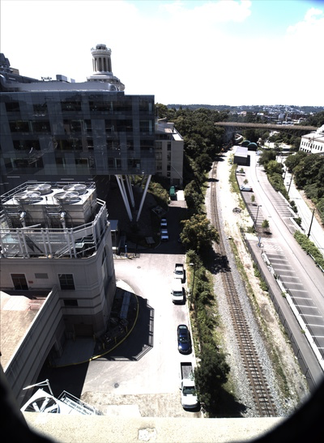
Basic DNN
.6
.1
.2
.1
Notes:
DNN/transfer learning background

Slide 10
Training a DNN
Notes:
DNN/transfer learning background

Slide 11
Training a DNN
Notes:
DNN/transfer learning background

Slide 12
Training a DNN
Notes:
DNN/transfer learning background

Slide 13
Fine-tuning DNN #1
Notes:
DNN/transfer learning background

Slide 14
Fine-tuning DNN #1
Notes:
DNN/transfer learning background

Slide 15
Fine-tuning DNN #1
Notes:
DNN/transfer learning background

Slide 16
Fine-tuning DNN #1
Notes:
DNN/transfer learning background

Slide 17
Fine-tuning DNN #2
Notes:
DNN/transfer learning background

Slide 18
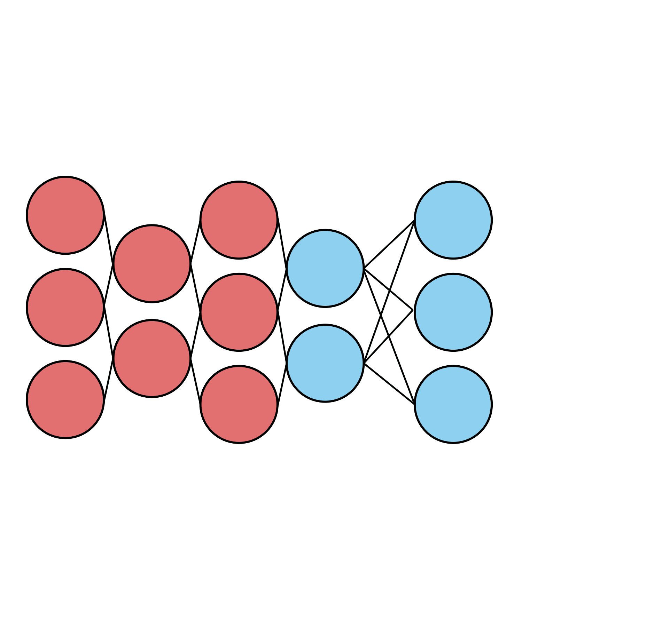
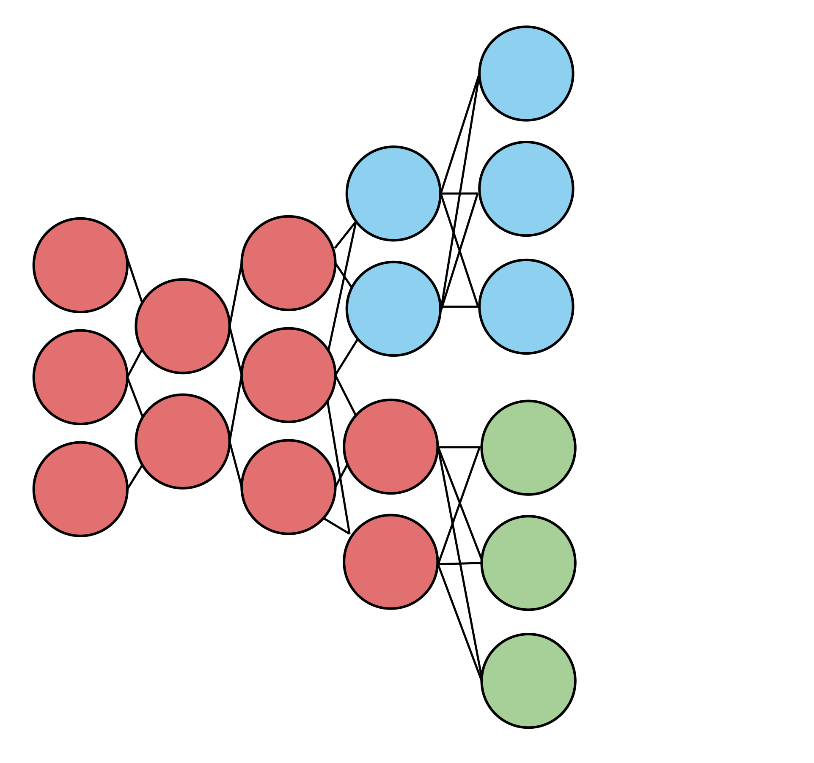
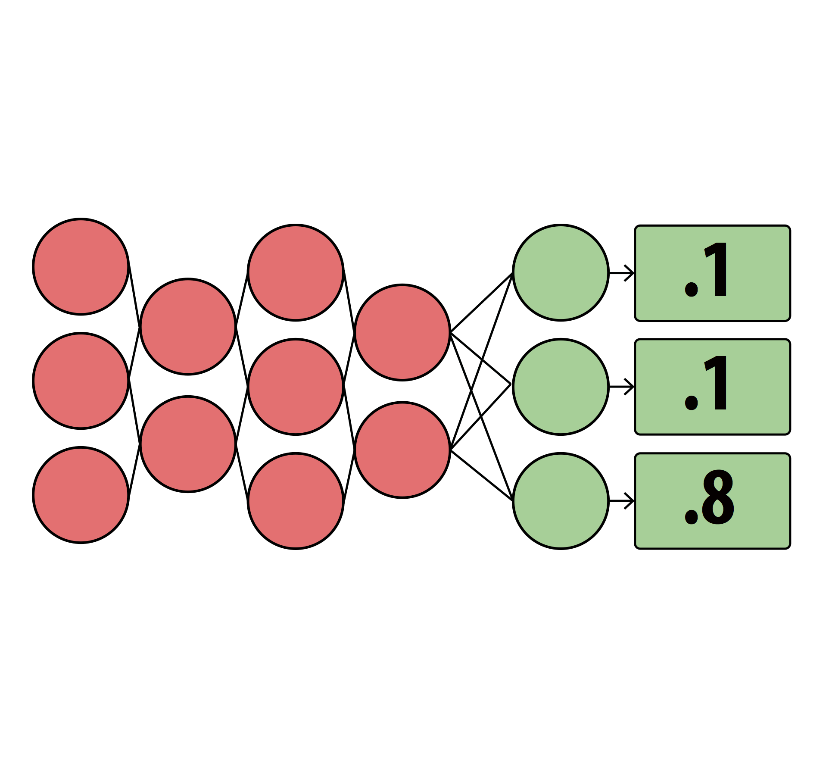
Two DNNs as run in Mainstream
Notes:
And you don’t know if that there’s similarities between with them. Did all of the red stuff twice. Base piece of our opportuniy. REd stuff doesn’t have to be done twicwe
Because the output of the red stuff is gonna be identical. Animate in merged DNNed. Number of bubbles you have to process are smaller, and if you have milions of bubbldes but hundreds of thousands of red bubbles

Slide 19
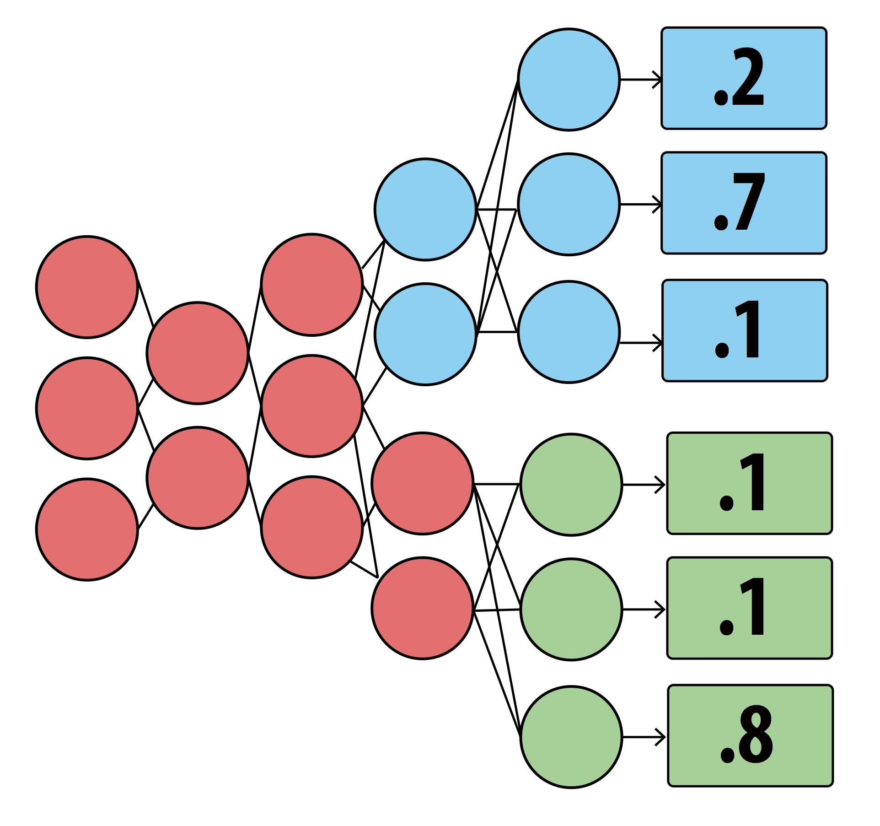
Two DNNs as run in Mainstream

Slide 20
Mainstream’s Approach
Merge the video stream processing of concurrent applications
Dynamically determine how much processing to share vs. specialize
Based on available resources, other applications
Maximize application effectiveness
Notes:
Usually transfer learned, and usually transfer learned using same base application
But network is trained independently (nobody ever remembers that they’re off the same base, we think there’s an opportunity there to share part of the network)
Processing rate
That’s if app developers figure out how much to specialized. They don’t think about sharing, and decision is being made independently of how much resourcdes are available. NOt gonna make good resources if this decision is made at application development

Slide 21
Performance trade-offs from specialization

Slide 22
More sharing = Higher throughput
More specialization = Higher per-frame acc.

Slide 23
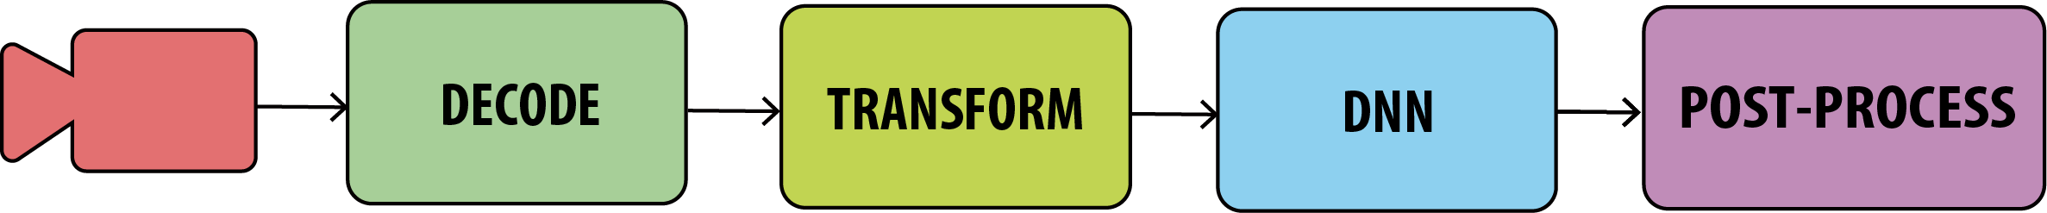
Experimental setup
Run concurrent image classification pipelines
Performed with InceptionV3 and MobileNets-224 DNNs
Hardware: Intel NUC
Video stream: 20FPS, 640x480

Slide 24
Less Specialized ➝ Faster processing (FPS)
Running image classifiers with InceptionV3
Notes:
Build this
Talk about red line first and more
That change dramatically as soon as we add one more app

Slide 25
Less specialized ➝ Lower per-frame acc.
Running image classifiers with MobileNets

Slide 26
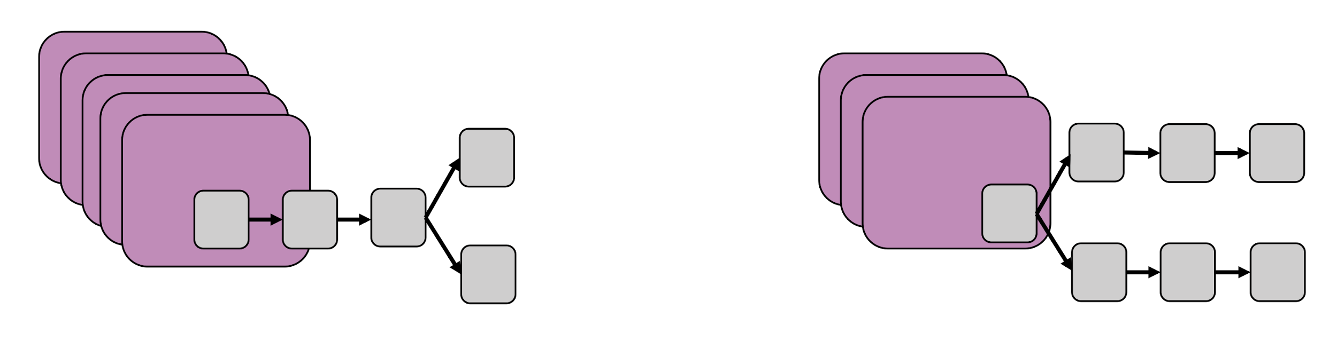
Sample more or specialize more?
Notes:
Use actual frames

Slide 27
How to measure application performance?

Slide 28
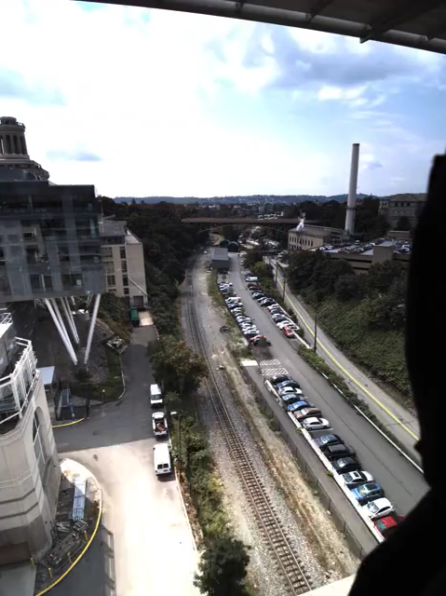
App example: Event detection
Notes:
Grey out
Hammer on *front* of the train, so needs to be one of the two

Slide 29
Goal: Maximize Event-F1 score
Event-Recall: How many relevant events are detected?
Event-Precision: How many detected events are relevant?
Event-F1 score: Harmonic mean between precision and recall
Notes:
Precision -> opposite of FNR

Slide 30
Effect of accuracy and FPS on F1-score

Slide 31
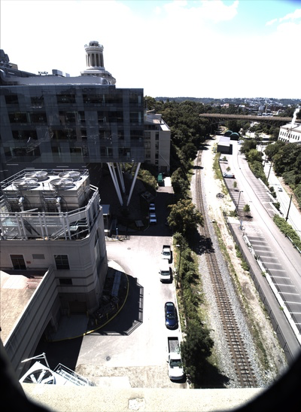
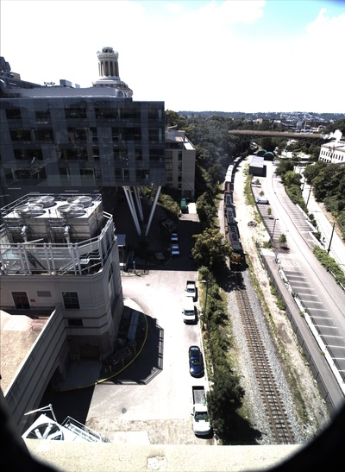
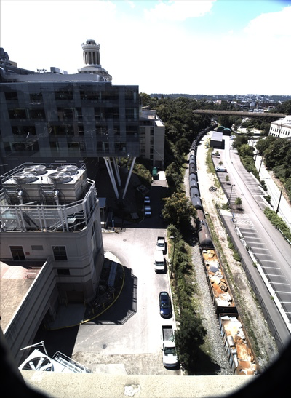
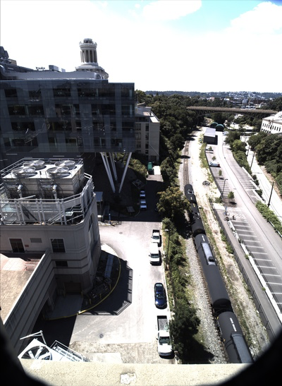
App example: Event detection
Notes:
Grey out
Hammer on *front* of the train, so needs to be one of the two

Slide 32
App example: Event detection
Notes:
Grey out
Hammer on *front* of the train, so needs to be one of the two

Slide 33
App example: Event detection
Notes:
Grey out
Hammer on *front* of the train, so needs to be one of the two

Slide 34
App example: Event detection
Notes:
Grey out
Hammer on *front* of the train, so needs to be one of the two

Slide 35
App example: Event detection
Notes:
Grey out
Hammer on *front* of the train, so needs to be one of the two

Slide 36
Challenge of searching the state-space
Requires joint optimization between applications
Combinatorially large state space
Analytically model the function between FPS, accuracy and F1-score
Notes:
Precision -> opposite of FNR

Slide 37
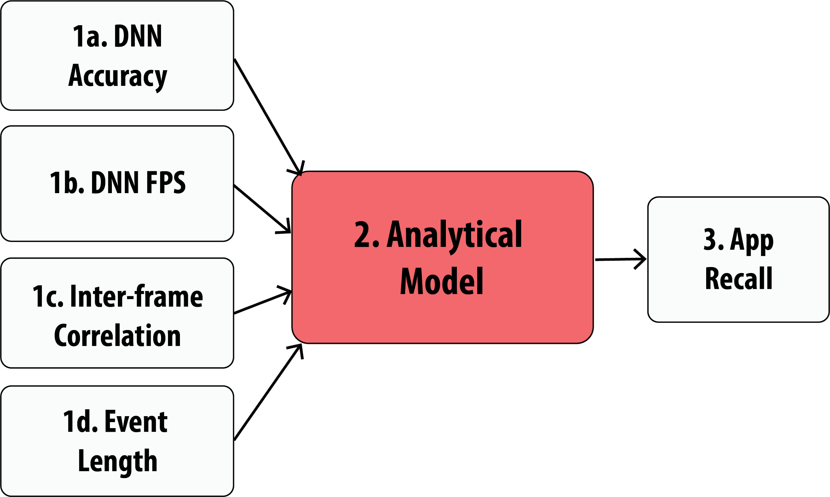
Analytical model for application quality
Notes:
Precision -> opposite of FNR

Slide 38
Analytical model for application quality
Notes:
Precision -> opposite of FNR

Slide 39
Estimating application quality
Notes:
Precision -> opposite of FNR

Slide 40
Estimating application quality
Notes:
What you say for the first frame is the same as what you’ll say for the second frame

Slide 41
Estimating application quality
Notes:
Precision -> opposite of FNR

Slide 42
Mainstream’s architecture

Slide 43
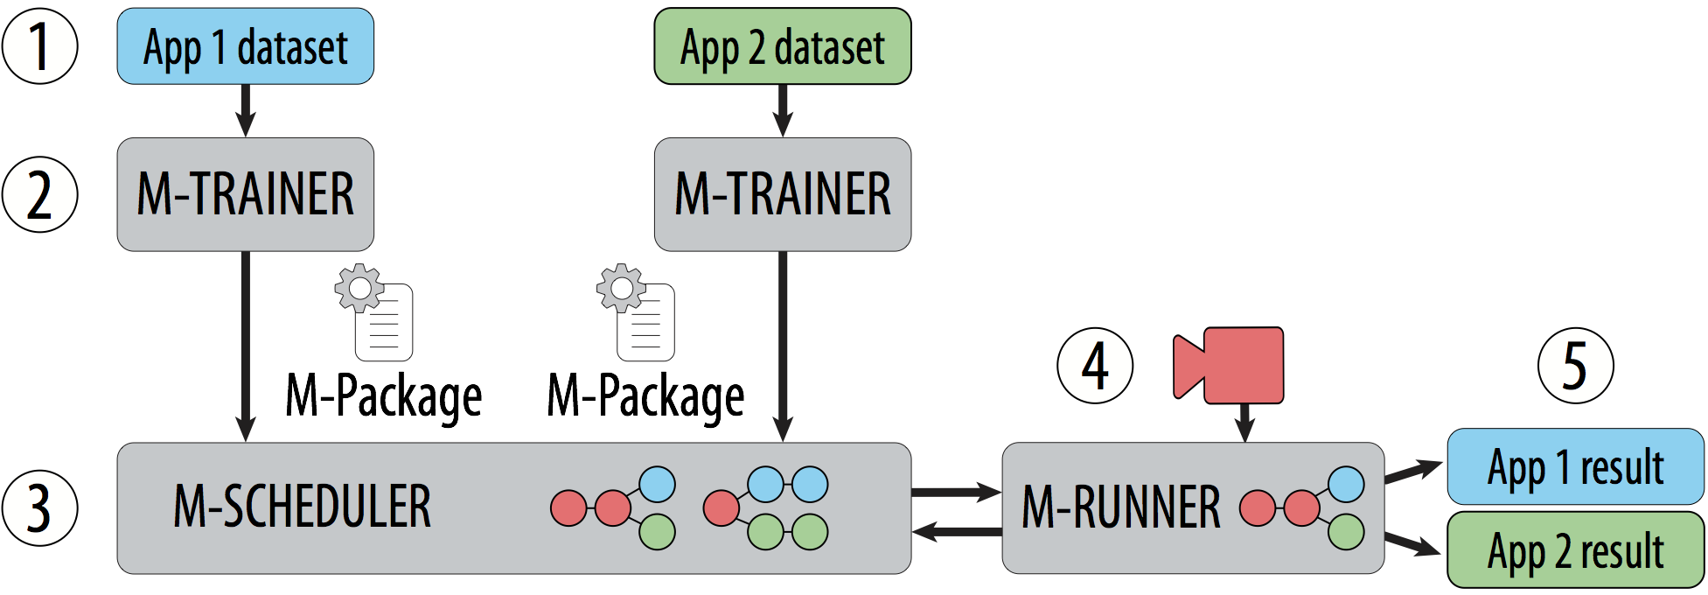
Mainstream architecture

Slide 44
Decentralized, sharing-aware, training
% specialized | Top1 Acc. | Model
Minimum event length = 50ms
Inter-frame correlation = 0.8
Notes:
In Mainstream training does not require centralized control of the data or training process
Each M-trainer is run locally by the app developer
It helps the app developer create and save the necessary information for scheduler to determine the amount of specialization at runtime
In particular, M-trainer creates model sets. So, instead of training one model, it trains multiple model candidates, each with a different amount of specialization (aka sharing potential)
It also saves important metadata
Most importantly, our model sets allow the late binding of how much specialization is used at runtime
And M-Trainers can be run independently and at different times by the application developer

Slide 45
Mainstream architecture

Slide 46
Dynamic, sharing-aware, scheduling
Input: M-Package
Model Sets, Min event length, Inter-frame correlation
Output: Number of task-specific layers and frame-rate (per application)
Maximize: F1-score (across applications)
Approach: Greedily choose moves with maximum cost-benefit ratio
Benefit: from analytical model
Cost: Relative latency-based cost
Use X-voting to improve precision
Notes:
WITHIN A COMPUTATIONAL BUDGET (modeled as a cosest)

Slide 47
Mainstream’s evaluation

Slide 48
Experimental setup
Run concurrent image classification pipelines
Performed MobileNets-224 DNNs
Applications: Pedestrians, Cars, Flowers, Cats
Hardware: Intel NUC
Video stream: 20FPS, 640x480

Slide 49
Mainstream improves F1-score up to 28X
Notes:
We compare against 2 static approaches
No sharing is one end of the extreme where we deploy a full DNN for every applications
Max sharing conservatively shares all but the last layer
No sharing performs well when resources aren’t constrainted and it’s able to run its fully-specialized networks at a high enough frame rate
No Sharing’s frame-rate degrades quickly and it soon begins to miss events
Max sharing is able to scale a lot better, but often underutilizes resources, never achieving a high model accuracy

Slide 50
Mainstream balances recall and precision

Slide 51
Mainstream Conclusion
Enables efficient processing of a set of dynamic applications
By sharing DNN computation
Determines how much of each network to specialize at runtime
Uses analytical model to perform joint optimization
Up to 28X improvement in F1-score, compared to No Sharing
Up to 71% improvement in F1-score, compared to Max Sharing

Slide 52
X-voting must also be tuned dynamically

